Slide 1
Distances to Globular Clusters using RR Lyrae Variable Stars
By: Luke Bischoff
Supervisor: dr Victoria scowcroft
Notes:
Hello and welcome to my talk on measuring distances to globular clusters using RR Lyrae variable stars!

Slide 2
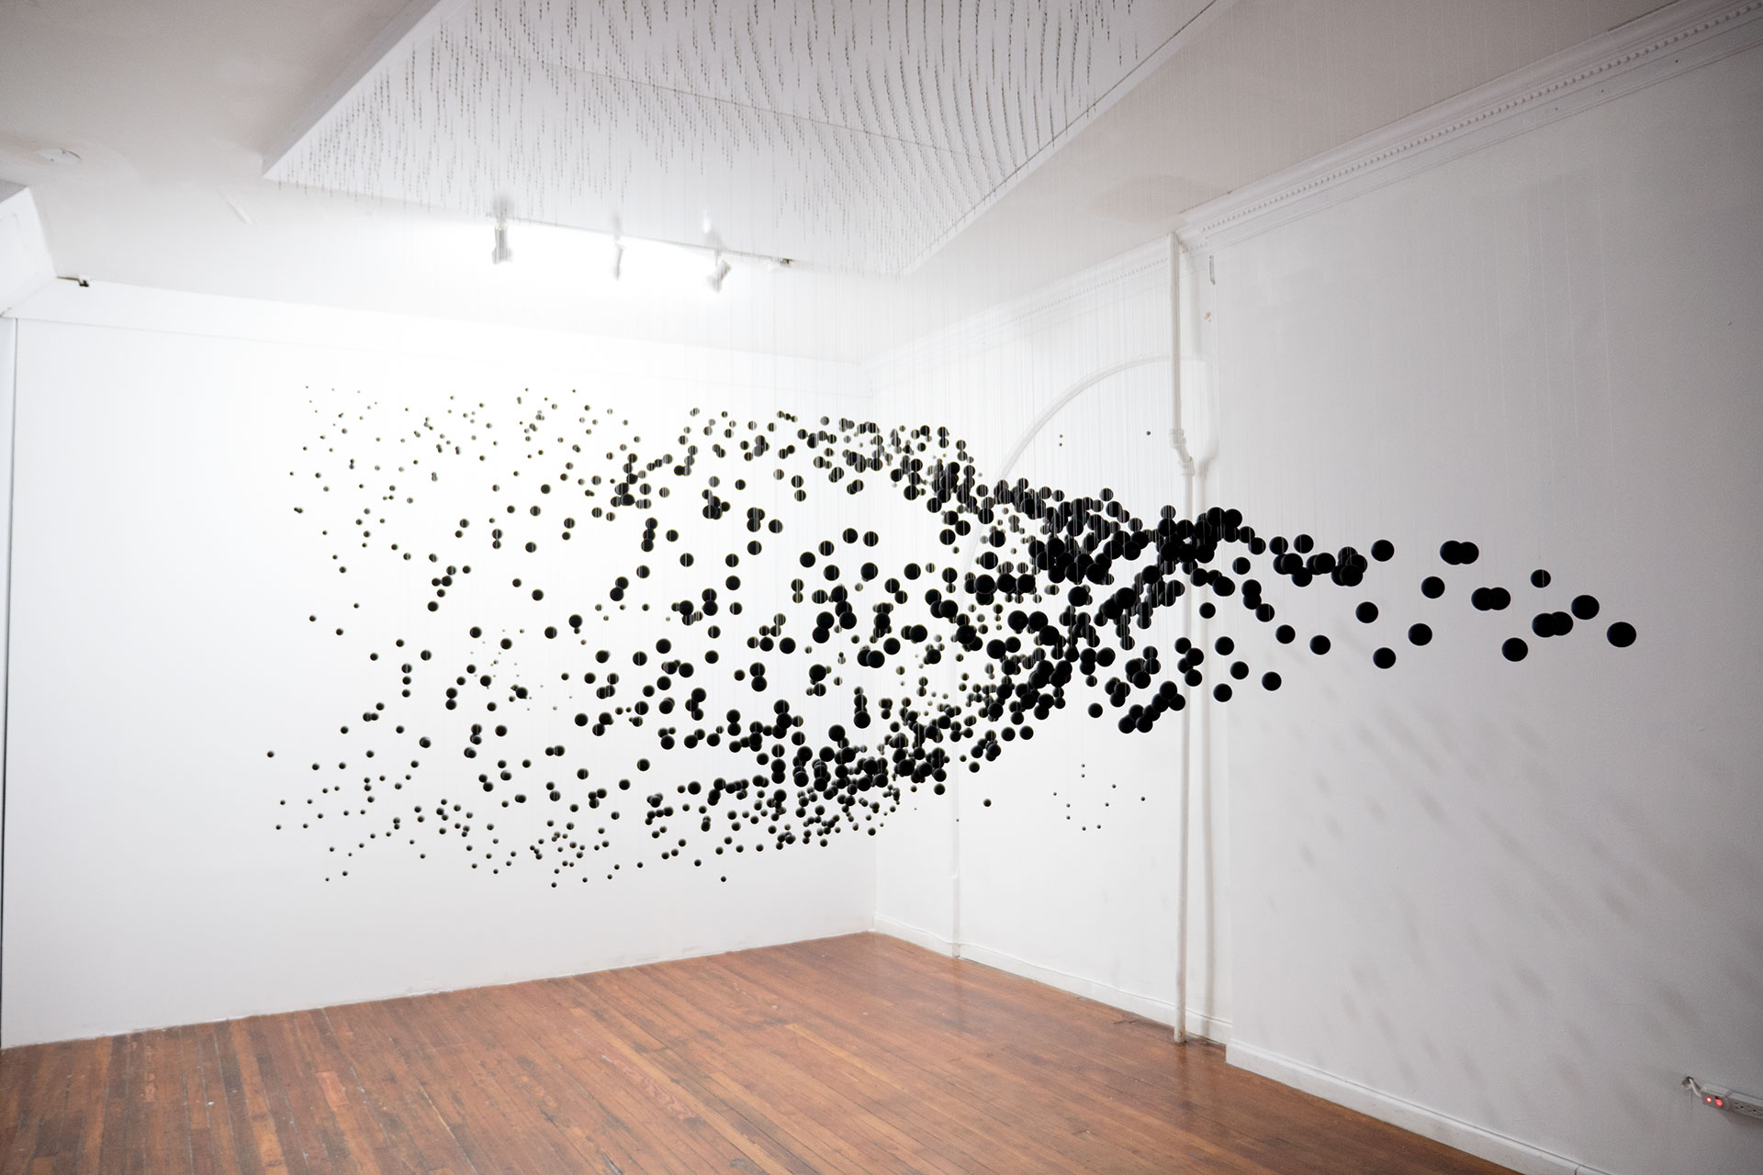
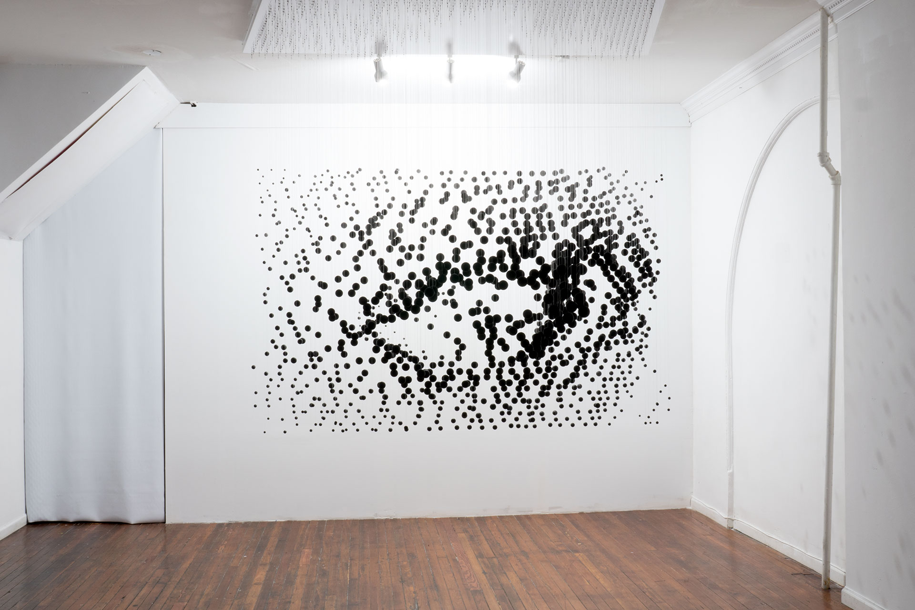
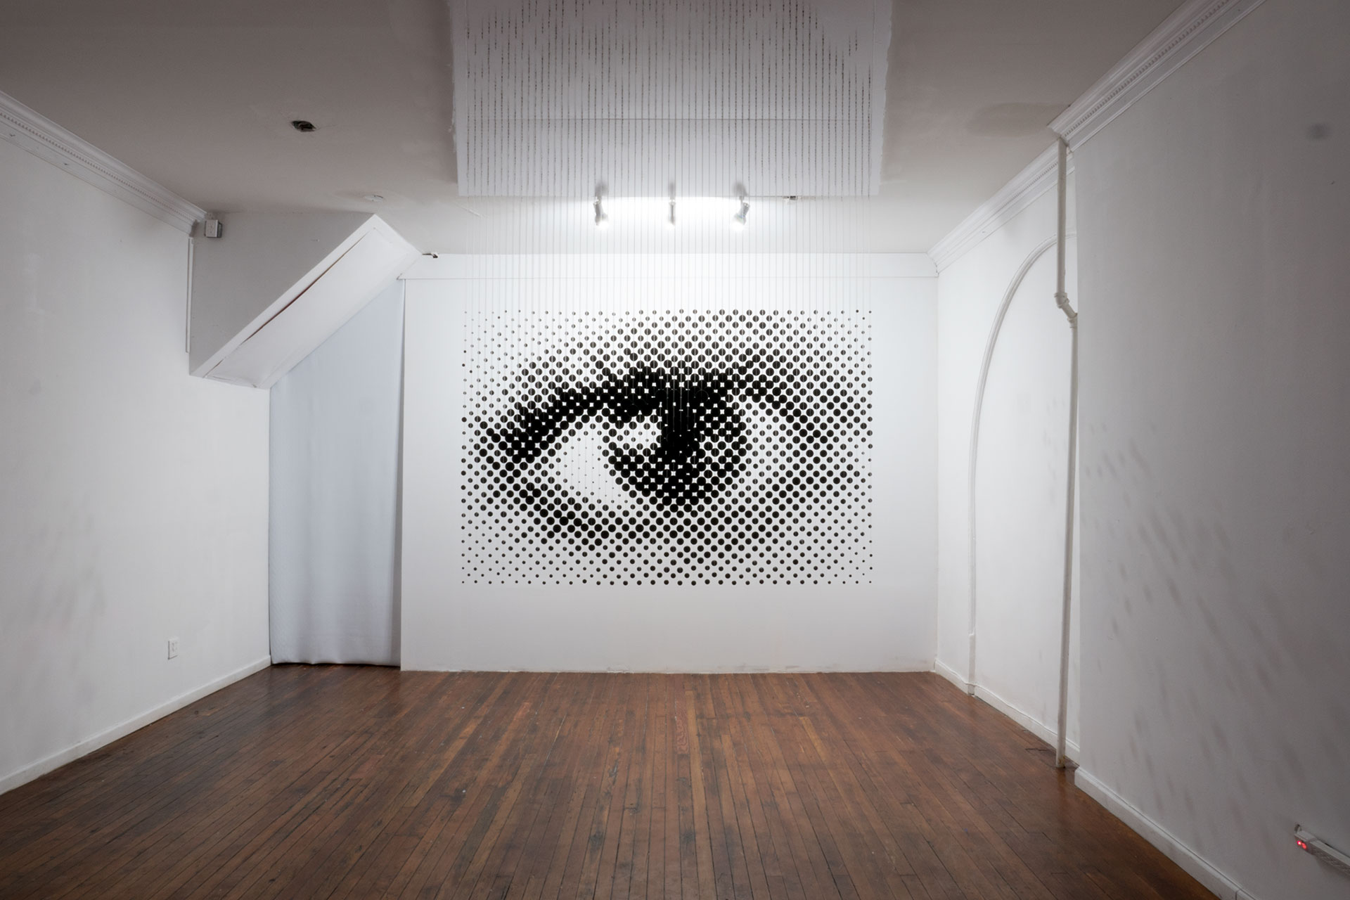
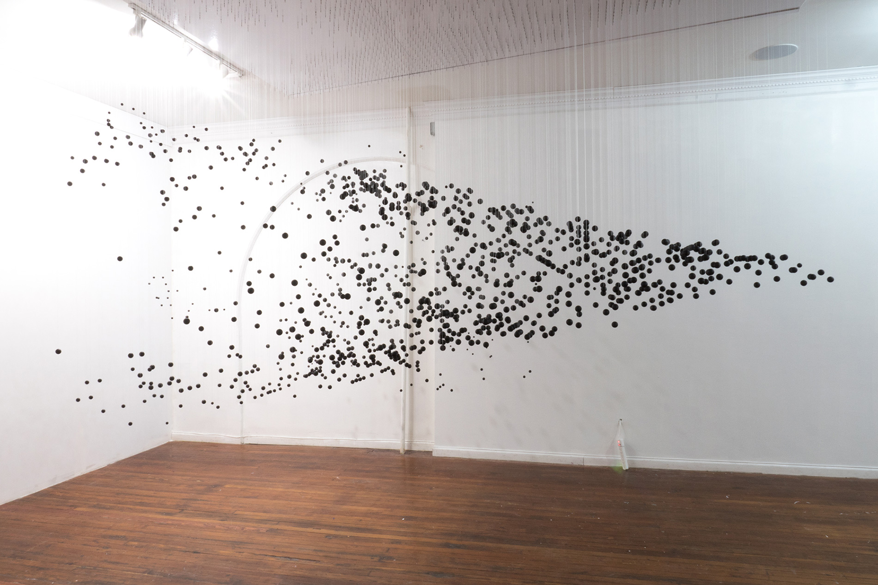
Cosmological distances
Measurement of distances to objects in the Universe is difficult
How can we measure these distances?
Why do we measure these distances?
Source: Michael Murphy
https://www.perceptualart.com/portfolio.html
Notes:
Measuring distances to objects within the universe is very difficult, mostly because we don’t have all the information directly available and to us on Earth, space looks as though it is a 2-D plane.
The image slideshow, using images made by Michael Murphy, in the bottom right demonstrates this issue, as the perspective changes it becomes clear all the individual balls are at greatly different distances from the original observation point.
This presentation will hopefully give some insight into how we can measure cosmological distances and why we might measure them.

Slide 3
The SMHASH and CRRP programs
Spitzer Merger and Shape of the Galactic Halo (SMHASH)
Aims to construct 3D map of the Milky Way (MW) galaxy
Uses mid-infrared observations of RR Lyrae (RRL) variable stars in globular clusters and dwarf Spheroidal galaxies (dSphs) of the MW
Carnegie RR Lyrae Program (CRRP)
Aims to study RR Lyrae in the MW galaxy
Together these programs are reliant on accurate distance measurements
Notes:
Observations taken as part of two key programs: SMHASH, the spitzer merger and shape of the galactic halo program and CRRP, the Carnegie RR lyrae program, were used in for this project.
SMHASH’s main aims are to investigate the Milky Way’s merger history and to construct a 3D map of the Milky Way, mainly it’s halo, by using mid-infrared wavelength observations of RR Lyrae stars.
SMHASH uses observations as part of its complementary program, CRRP, which primarily studies RR Lyrae stars in the Milky Way.
These programs are therefore reliant on accurate distance measurements and are within the research scope of this project, and our supervisor’s research interests as part of the Astrophysics research group here at Bath.

Slide 4
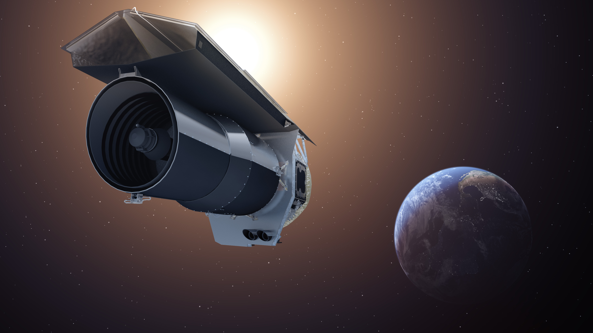
The Spitzer Space Telescope
The mission launched on the 25 August 2003 and retired on the 30 January 2020
Main instrument - Infrared Array Camera (IRAC):
Sensitive to the 3.6 μm, 4.5 μm, 5.8 μm and 8 μm wavebands
Only the 3.6 μm and 4.5 μm waveband cameras worked after Spitzer’s cryogen ran out in 2009
Start of the Spitzer Warm Mission
Spitzer Space Telescope (Artist’s Impression)
Source: NASA/JPL-Caltech
Notes:
A few brief facts about the Spitzer space telescope:
The telescope was in operation for just under 17 years, far outliving it’s planned mission duration of 2.5 to 5 years.
The main instrument of interest is the Infrared Array Camera, IRAC. This camera contains an array of 4 detectors, each most sensitive to slightly different wavelengths of light: 3.6 microns up to 8 microns as shown.
The two larger waveband camera required cooling, supplied by a cryogen, which ran out in 2009 resulting in just the 3.6 and 4.5 micron cameras operational; signalling the start of the Warm Mission.

Slide 5
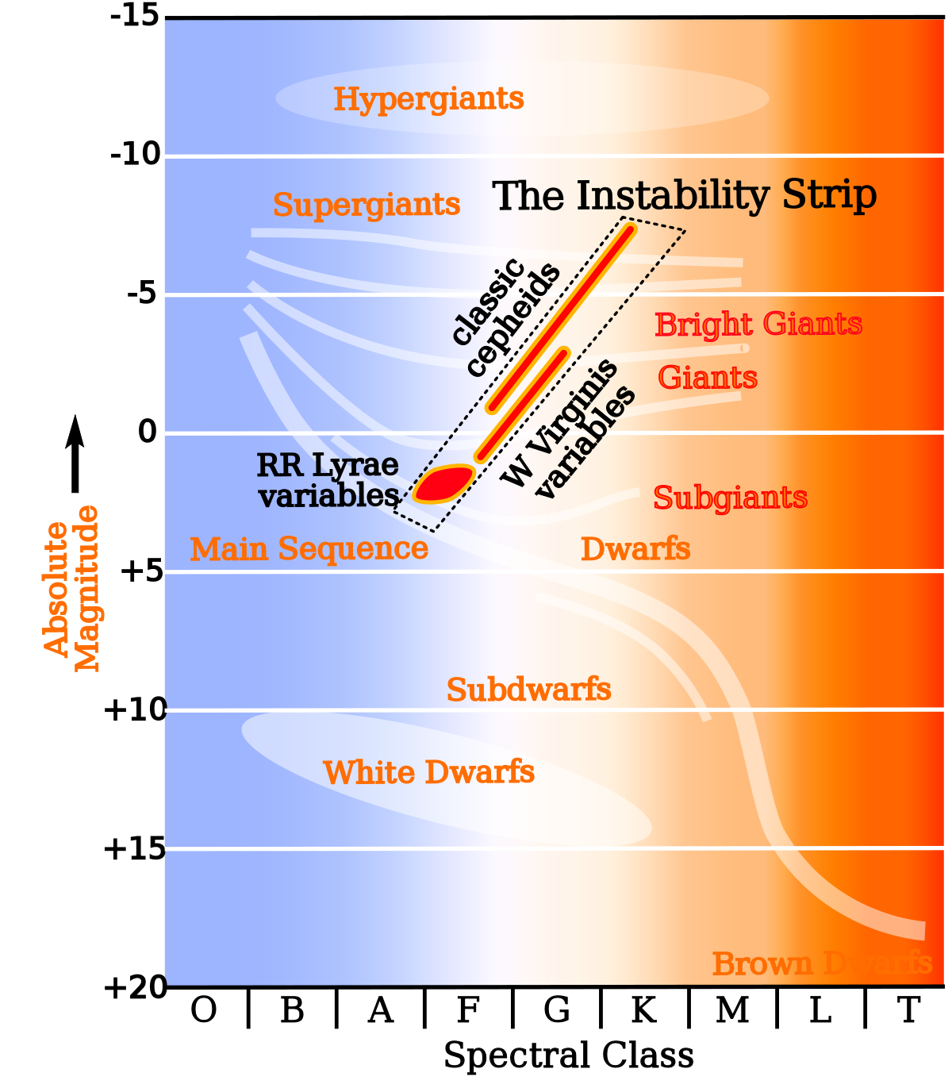
RR Lyrae variable stars
RR Lyrae (RRL) are Population II stars:
Relatively old (> 10 billion years)
Low overall metallicity (metal poor)
Luminosity varies with periods of around a few hours to a day
Typically less massive than the Sun (0.5 - 0.8 solar masses)
Abundant in globular clusters residing in the MW galaxy
Lie on the instability strip of HR diagram
RRLs are used as standard candles
Source: https://commons.wikimedia.org/wiki/File:HR-diag-instability-strip.svg
Notes:
RR Lyrae variable stars are a type of variable star whose luminosity varies with periods of around a few hours up to a day. These stars belong to Population II which means they’re relatively old, greater than 10 billion years, slightly less massive than our Sun, about 0.5 to 0.8 solar masses and have low overall metallicities.
The Hertzsprung-Russell diagram shows where these stars reside, just off the main sequence, on the instability strip, which is home to several other types of pulsating variables, such as Cepheids.
RR Lyrae are particularly abundant residents within globular clusters in the Milky Way galaxy, making these stars particularly useful for study – especially as they’re what are known as standard candles. Standard candles are essentially markers to calibrate distances to cosmological objects!

Slide 6
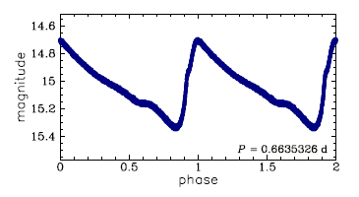
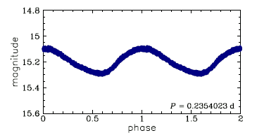
Types of RR Lyrae
RRab:
Pulsate in the fundamental frequency
Typically larger amplitudes and longer periods
RRc:
Pulsate in the first overtone
Typically smaller amplitudes and shorter periods
More sinusoidal and symmetrical
RRd:
Pulsate in both fundamental frequency and first overtone simultaneously
Top: RRab
Bottom: RRc
Credit: Soszyński & The OGLE Project
Source: http://ogle.astrouw.edu.pl/atlas/RR_Lyr.html
Notes:
There are three main types of RR Lyrae: RRab types, which pulsate in the fundamental mode and characterised by larger amplitudes and longer pulsation periods: a typical RRab light curve is shown at the top.
RRc types, which pulsate in the first overtone and typically have smaller amplitudes and shorter periods – the bottom light curve shows a typical RRc type star, which is more symmetrical and sinusoidal than RRab types.
A final type, RRd, pulsates in both the fundamental and first overtone modes simultaneously.

Slide 7
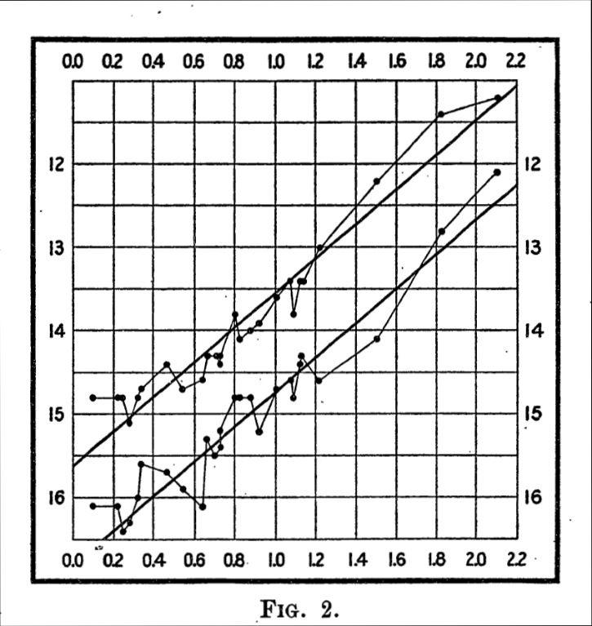
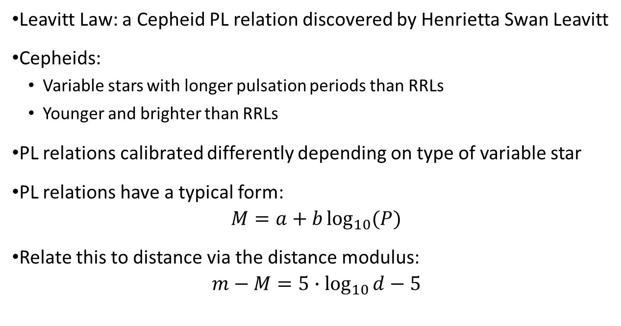


Cepheids and the Period-Luminosity relation
Leavitt Law: a Cepheid PL relation discovered by Henrietta Swan Leavitt
Cepheids:
Variable stars with longer pulsation periods than RRLs
Younger and brighter than RRLs
PL relations calibrated differently depending on type of variable star
PL relations have a typical form:
$$M=a+b\log_{10}{(P)}$$
Relate this to distance via the distance modulus:
$$m−M=5∙\log_{10}{d}−5$$
[1]
$$apparent magnitude$$
[1] Leavitt H S and Pickering E C 1912 Harvard College Observatory Circular 173 1-3
$$\log_{10}{P}$$
Notes:
Previous work on pulsating variables has often focused on Cepheid variables. These are similar to RR Lyraes but are younger, brighter and have longer pulsation periods, on the order of weeks. In 1908, Henrietta Swan Leavitt discovered the Leavitt law, which is the relationship between a Cepheid’s absolute magnitude and its period of pulsation.
These are known as period-luminosity relations or PL relations.
The PL relation shown is the original Cepheid PL relation published in 1912, to give an idea on what a PL relation is, how they look and their history because they’re integral to finding distances to objects!
Cepheids, being brighter have been used in the past to calculate distances on cosmological scales but RR Lyraes could provide some advantages over Cepheids, mainly due to RR Lyrae PL relations having less dispersion (or scatter) about them.
PL relations are dependent on the type of variable star being studied, but generally have a form similar to the one shown. These can then be related to distance in parsecs using the distance modulus, provided you have apparent magnitudes for the stars in the sample.

Slide 8
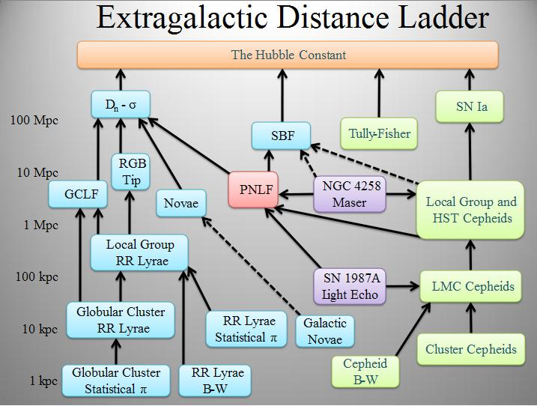
Cosmic distance ladder
Calibrate cosmological distances
Aim of accurately determining the Hubble constant
Cepheid route previously used to climb the ladder (green boxes)
An independent route using RRLs can be climbed to obtain more accurate values for the Hubble constant
Each rung provides information that can be used to progress to the next rung
Ciardullo R 2004, eprint arXiv:astro-ph/0407290
https://commons.wikimedia.org/wiki/File:Extragalactic_distance_ladder.jpg
Notes:
This leads us to the cosmic distance ladder, which is a process of using cosmological distances at different scales in order to calibrate the distances of cosmological objects. The ultimate aim of the cosmic distance ladder is to determine accurate values for the Hubble constant.
There are two main routes in the diagram: the previously well climbed Cepheid route, following the green boxes on the right as well as an independent route on the left hand side, using RR Lyraes. The general hope in the field is that this RR Lyrae route will obtain more accurate values for the Hubble constant.
We’re starting around the bottom rung of the ladder: globular cluster RR lyraes and each rung provides more information for progression onto the next one, gradually increasing in distance.

Slide 9
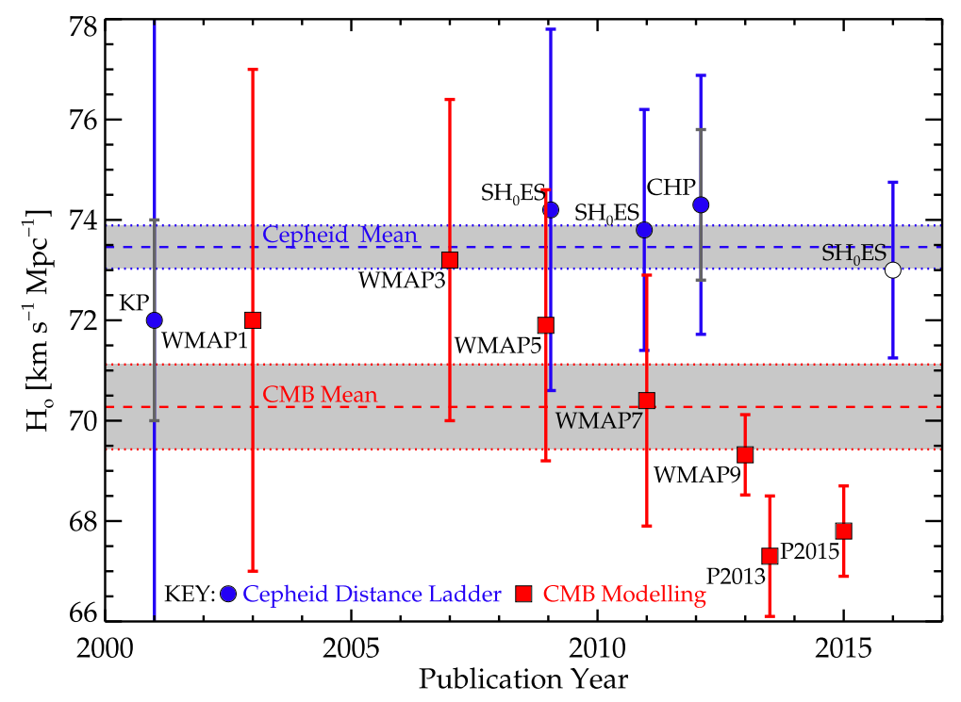
The Hubble Constant
Fundamental disagreement in value depending on method:
Classical Cepheids: 73.5 kms⁻¹Mpc⁻¹
CMB: 70.5 kms⁻¹Mpc⁻¹
RRLs could prove a useful route up the cosmic distance ladder
Obtain more accurate values for the Hubble constant to resolve this inconsistency
Far reaching implications on our understanding of the Universe
[1]
[1] Beaton R L et al. 2016 The Astrophysical Journal 832 210
Notes:
Determinations for the Hubble constant appear to be inconsistent depending on the approach used to obtain it. Values of around 73.5 kilometres per second per mega parsec have been found using the Cepheid distance ladder, where as values of 70.5 kilometres per second per mega parsec have been found using the cosmic microwave background, as shown in the diagram.
The issue is that even though in the past 15 years uncertainties have been gradually decreasing, the disagreement remains, but by using a completely independent route using RRLs, a resolution can be found to this disagreement and provide accuracies down to 2 or 3%.
This has exciting implications on our understanding of the Universe, particularly in confirming details regarding its age, size and evolution.

Slide 10
Data selection
Data information:
Regions of around 6×15 arcminutes around the centre of globular clusters
Data obtained in both the 3.6 μm (channel 1) and 4.5 μm (channel 2) wavebands
12 epochs of data taken over at least one full cycle for the longest period RRL in the cluster
Data processing:
Raw data pre-processed into basic calibrated data (BCD) frames to reduce images
Epoch mosaic frames for each channel created by project supervisor
Master mosaic frames also created – these have a higher SNR
Notes:
We now move onto the methodology section!
The data from IRAC was pre-processed into what is known as basic calibrated data (BCD) frames which follows an established pipeline. This involves things like image reduction: such as corrections for pixel sensitivity and any biases; this was all done prior to receipt of the data.
The observations of the globular clusters involved 12 epochs in series, spread over a duration of the RR Lyrae with the longest period in the cluster and covered a region around 6by15 arcminutes around the centres.
Mosaic frames, which are a stitching together of BCDs, were created for each epoch by the project’s supervisor, resulting in the final data to be analysed.
Master mosaic frames were also created, so let’s take a look at them

Slide 11
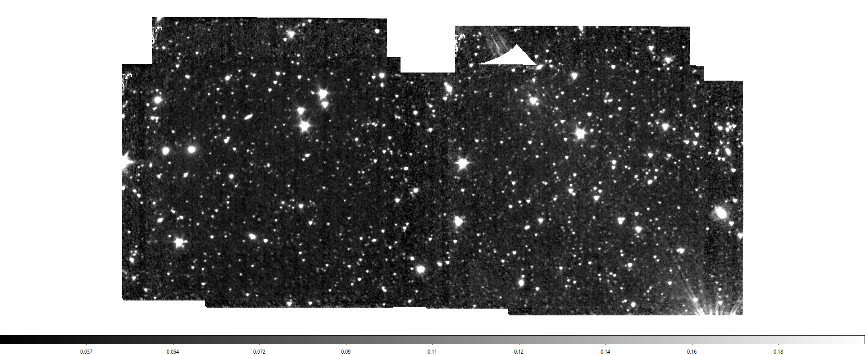
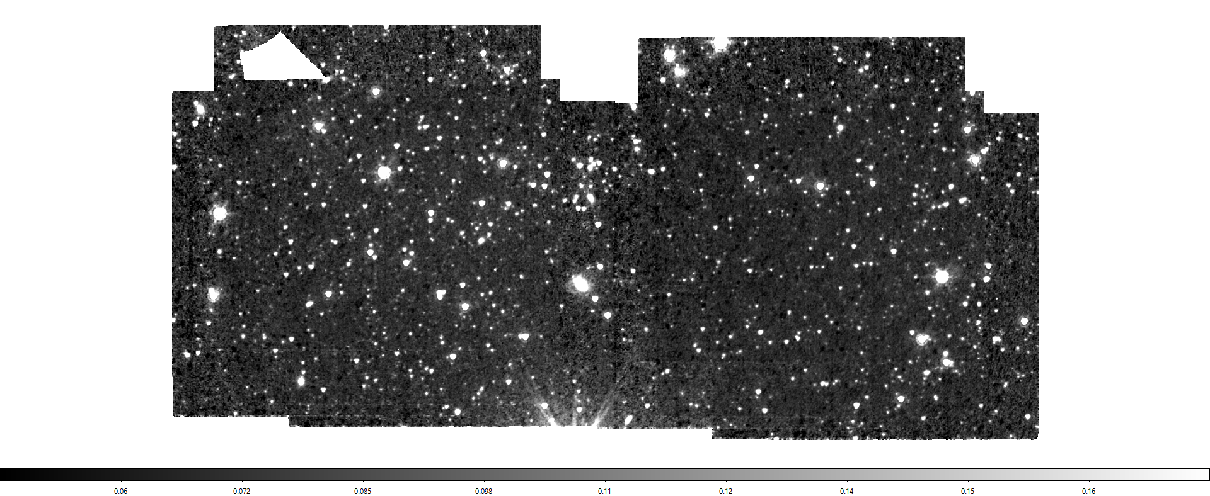
Master mosaic frames (Palomar 5)
Channel 1 (3.6 μm)
Channel 2 (4.5 μm)
Example of both channel 1 and channel 2 master mosaic frames (aligned, channel 1 overlaying channel 2)
Notes:
Here’s the master mosaic frame for Palomar 5, indicating the channel 1 and 2 regions, with channel 1 overlaying channel 2. These are basically a median image using data from across all 12 epochs, which is particularly useful as it gives them a higher signal to noise ratio than the individual epoch frames.
A quick note on SNR: for the SMHASH program, the data were optimised for channel 1, which resulted in channel 2 having lower SNRs than channel 1, this is particularly noticed in the epoch frames.

Slide 12
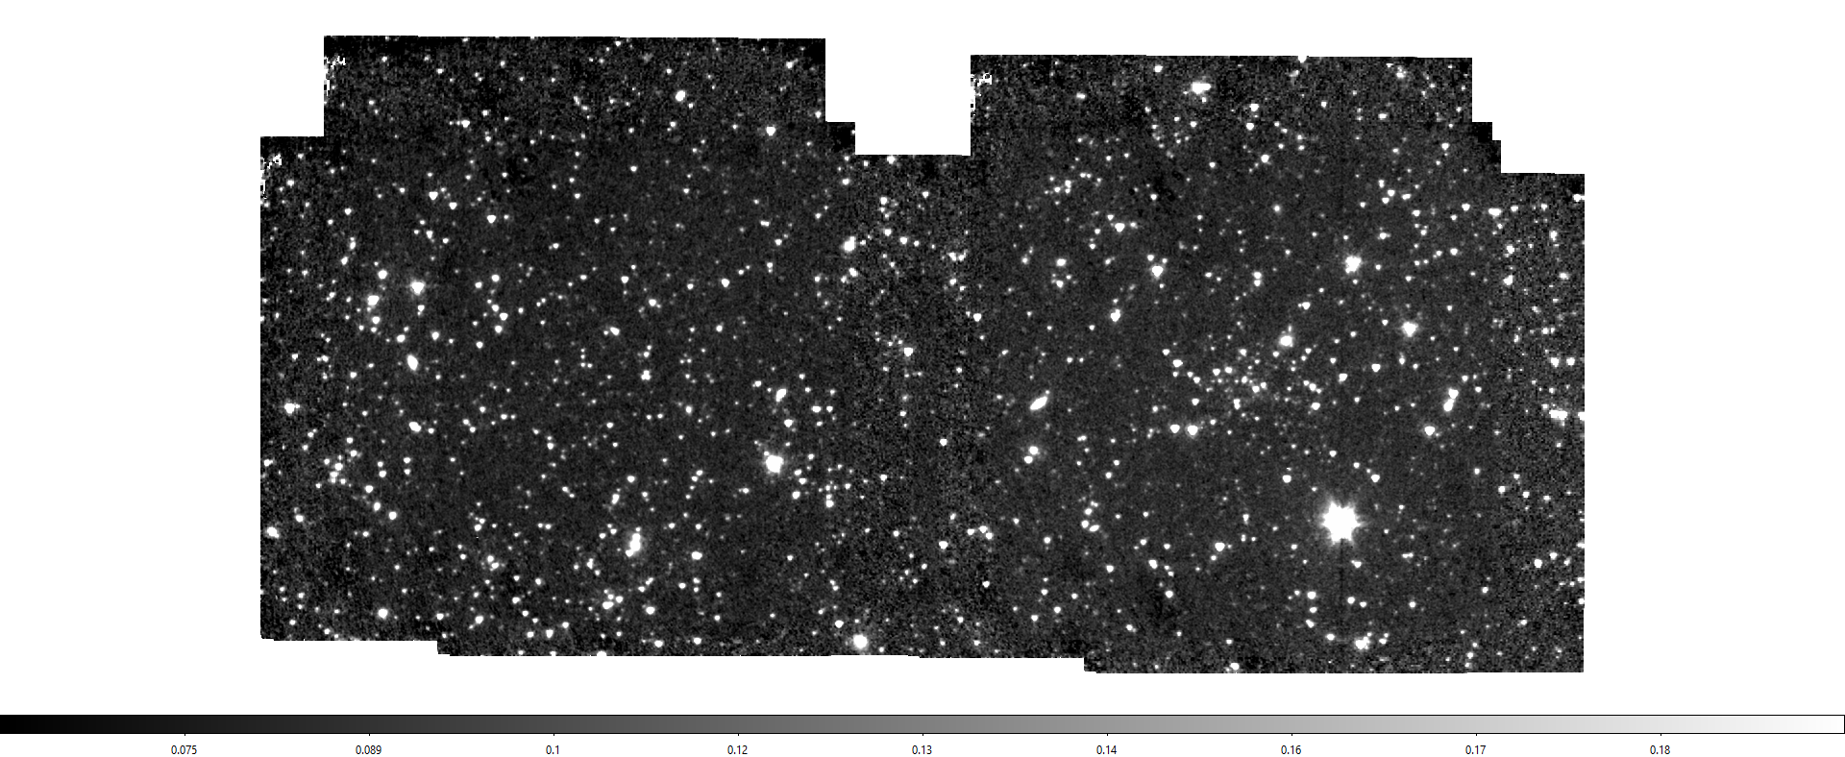
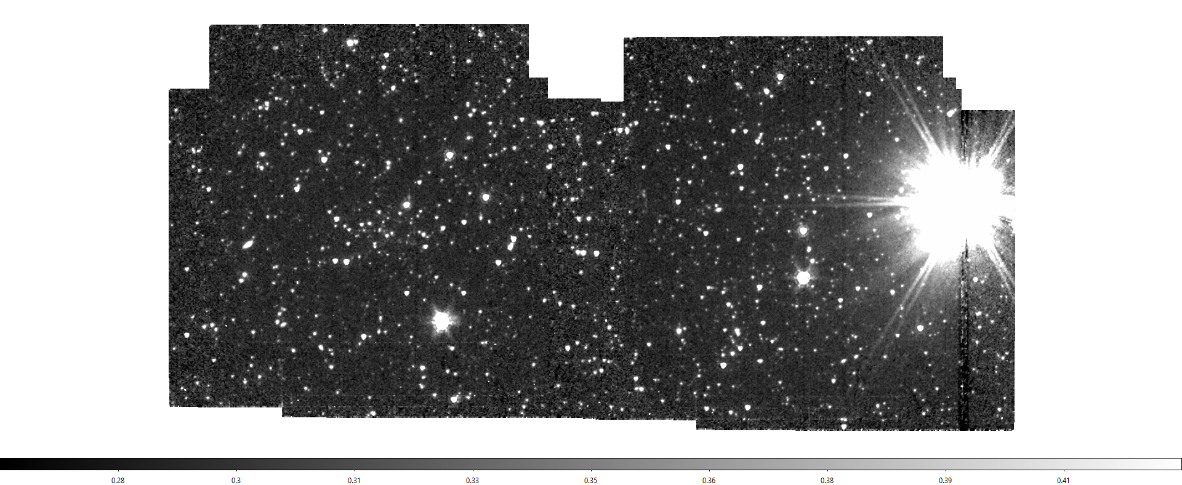
Master mosaic frames (Palomar 13)
Channel 1 (3.6 μm)
Channel 2 (4.5 μm)
Example of both channel 1 and channel 2 master mosaic frames (aligned, channel 1 overlaying channel 2)
METHODOLOGY
Notes:
This is the master mosaic frame for Palomar 13, the other globular cluster analysed. It is of note this bright star on the right, which is just over an order of magnitude closer to us than the cluster, which particularly affected the channel 2 data for Pal 13.
Both Pal 5 and Pal 13 exhibit long tidal streams as they are undergoing disruption by and accretion to the Milky way.
These master frames, owing to their higher SNR, were used to generate master source lists for use in the photometry…

Slide 13
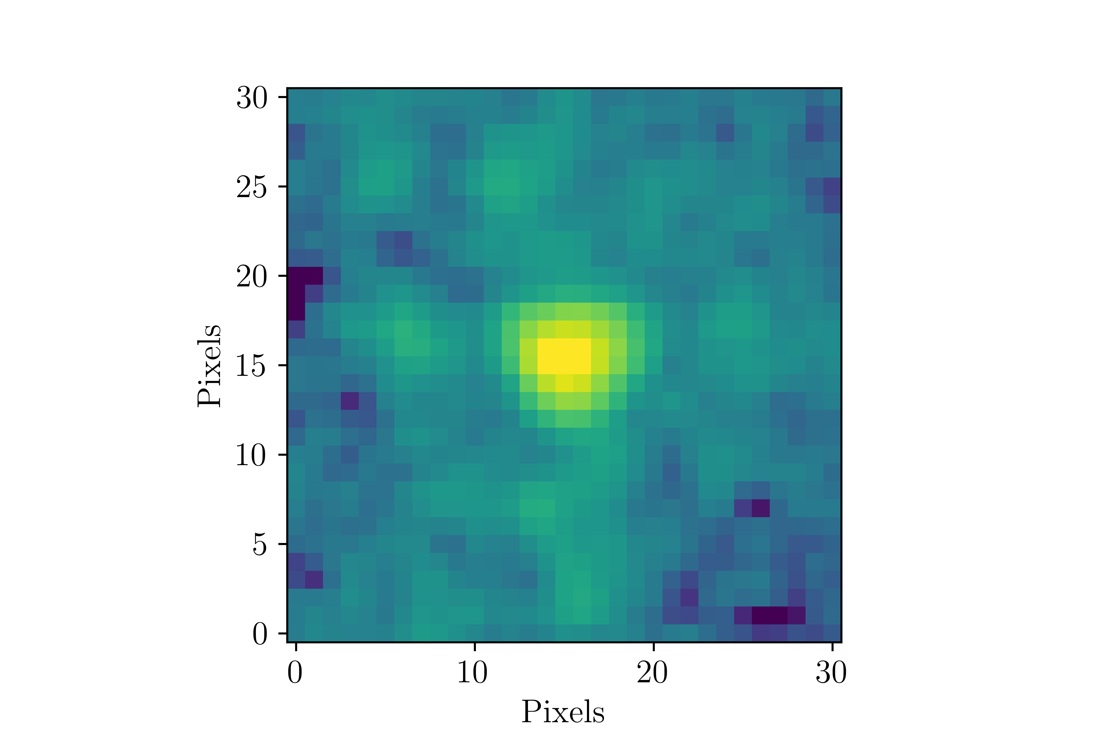
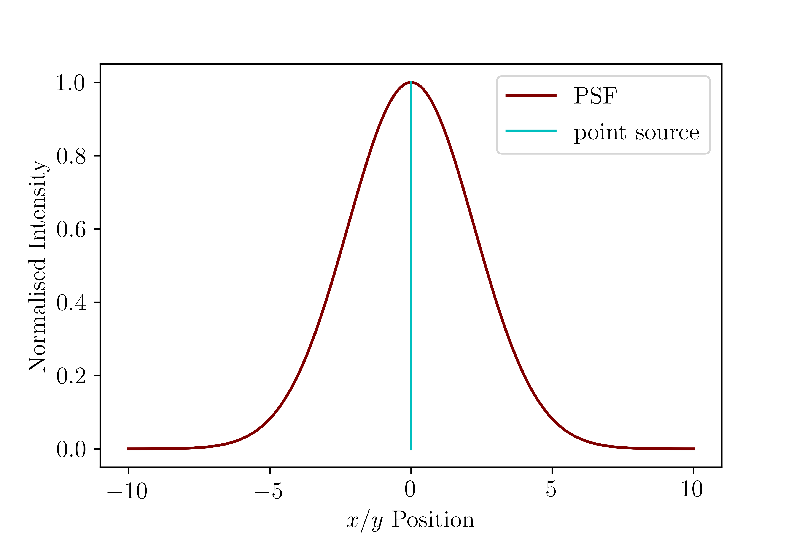
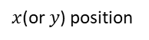
Photometry
Inner radius
Two main methods considered:
Outer radius
1. Aperture photometry
Measuring flux through an aperture of known radius
Subtract background from an annulus around star
2. Point spread function (PSF) photometry
Construct a point spread function based on the profile of point sources in the frame
Fit PSF model to the sources to measure their flux values
Normalised Intensity
$x$(or $y$) position
Notes:
Photometry is the measurement of the amount of light, or flux, from an image produced by a camera or detector. There are two main methods of photometry considered:
Aperture photometry: which is measuring the total amount of flux or data counts through an aperture drawn around the star: as shown by this inner radius in red here. The total amount of flux is also measured through an annulus region around the star, represented by this region bounded by the inner and outer radii: this value is the background flux and is subtracted from the total flux measured through the inner radius.
The second method, PSF, involves building a model based on the image profiles of the point sources produced by the detector in order to determine their flux. The graph shows the idea of a PSF, depicting a point source in light blue and a Gaussian PSF model in maroon. This example one is just a basic Gaussian PSF, the PSF is dependent on the instrument or detector used.
PSF was chosen due to its ability to handle crowded fields!

Slide 14
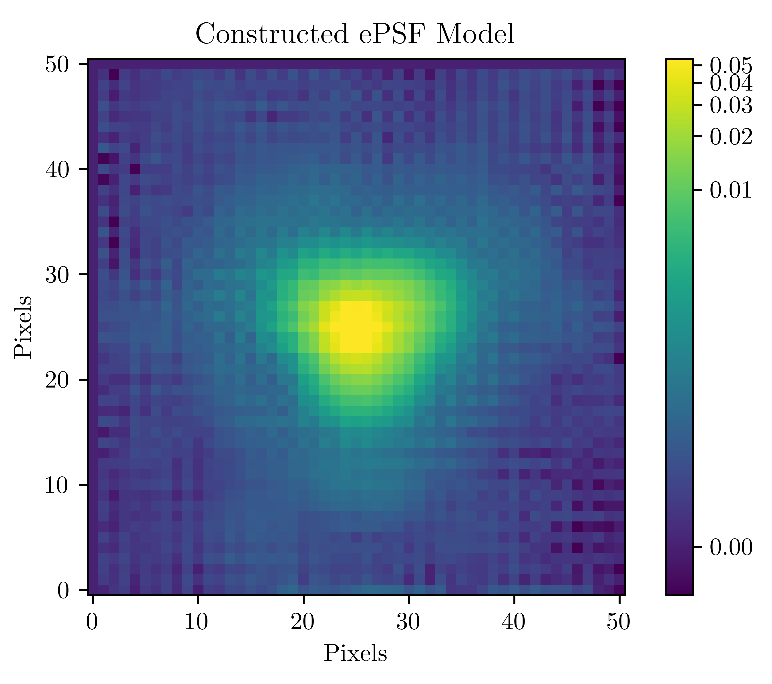
PSF models
Start
Master mosaic image
Run source detection algorithm
Build PSF model from star sample
Examine candidate PSF stars
No
Remove defective stars from list
Satisfactory PSF model?
PSF model generated
Yes
Notes:
Before obtaining flux values, the PSF model had to be built first, which follows this process:
A source detection algorithm with a high detection threshold value is used to detect candidate stars for the PSF model. The high threshold value is to ensure only the most well-sampled and high SNR stars are chosen. The PSF is then built and the candidate stars examined for defects such as nearby neighbours, blending (two unresolved stars or galaxies), or artifacts such as cosmic rays. These stars are removed and then the model rebuilt – if the model looks like a fair representation of a well-sampled Spitzer star: the model is used, an example of which shown for Pal 5 channel 1.

Slide 15
Performing photometry
Start
Epoch frame
Advance to next epoch (terminate after 12 epochs)
Join to master source list
Run source detection algorithm
Next iteration required?
Calculate apparent magnitudes
Match stars via coordinates to master source list
Yes
No
Fit PSF model to detected stars
Obtain flux values
Subtract detected stars from image (residual image)
Notes:
With the PSF model in hand, it’s time to do some photometry: this starts with the first epoch frame, and running the source detection algorithm with a threshold of around 6 standard deviations above the median value. The PSF model derived is then fit to the detected stars in order to obtain flux values. The detected stars are then subtracted from the image, leaving a residual image. Arriving at the junction there is a choice: to perform another iteration on the remaining stars in the residual image or to progress onto calculating apparent magnitudes. As Pal 5 and Pal 13 are relatively diffuse for globular clusters, only 2 iterations of photometry was required. Apparent magnitudes are then calculated from the flux values and the detected stars matched by their coordinates to the stars in the master source list mentioned before; the apparent magnitude data is then added to this list. Once complete, we advance to the next epoch frame and repeat the process until all 12 frames are analysed.

Slide 16
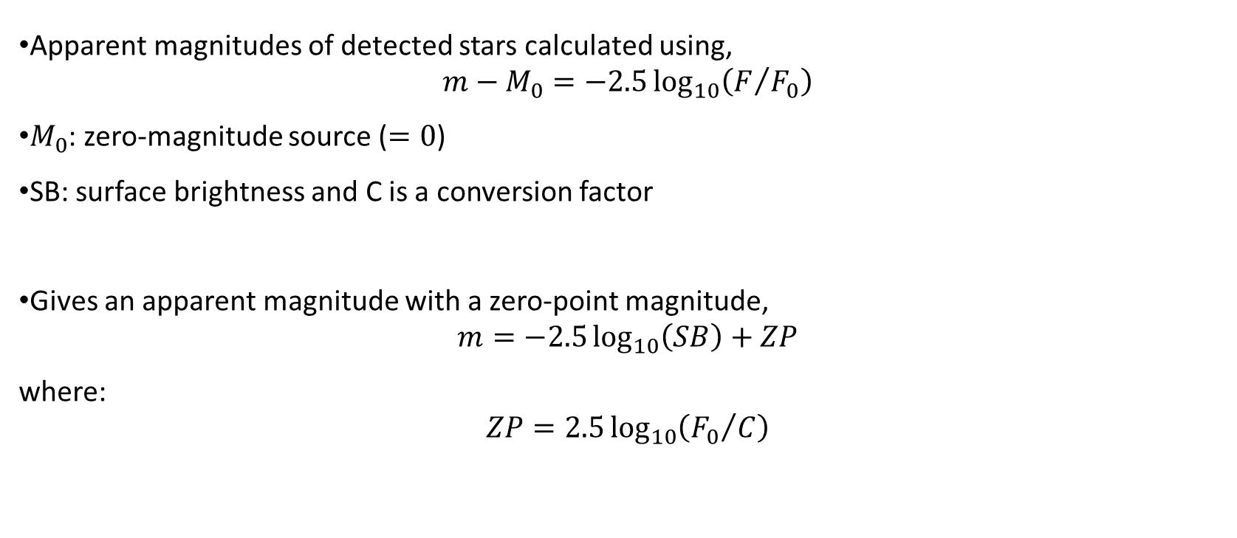
Apparent magnitudes
Apparent magnitudes of detected stars calculated using,
$$m−M_{0}=−2.5\log_{10}\left(F/{F_{0}}\right)$$
$M_{0}$: zero-magnitude source ($=0$)
SB: surface brightness and C is a conversion factor
Gives an apparent magnitude with a zero-point magnitude,
$$m=−2.5\log_{10}\left(SB\right)+ZP$$
where:
$$ZP=2.5\log_{10}\left({F_{0}}/C\right)$$
Reference material: https://irsa.ipac.caltech.edu/data/SPITZER/docs/irac/iracinstrumenthandbook/19/#_Toc59022370
Notes:
Apparent magnitudes are calculated using the equation shown, covered back in 1st or 2nd year. The logarithm can be split up and a conversion factor put in place because IRAC measures surface brightness, not flux. This conversion factor converts between mega Janskys per steradian, to micro Janskys per pixel. This conversion factor can then be used to calculate a zeropoint ZP, for each channel, the details of which were provided in the cameras handbook.

Slide 17
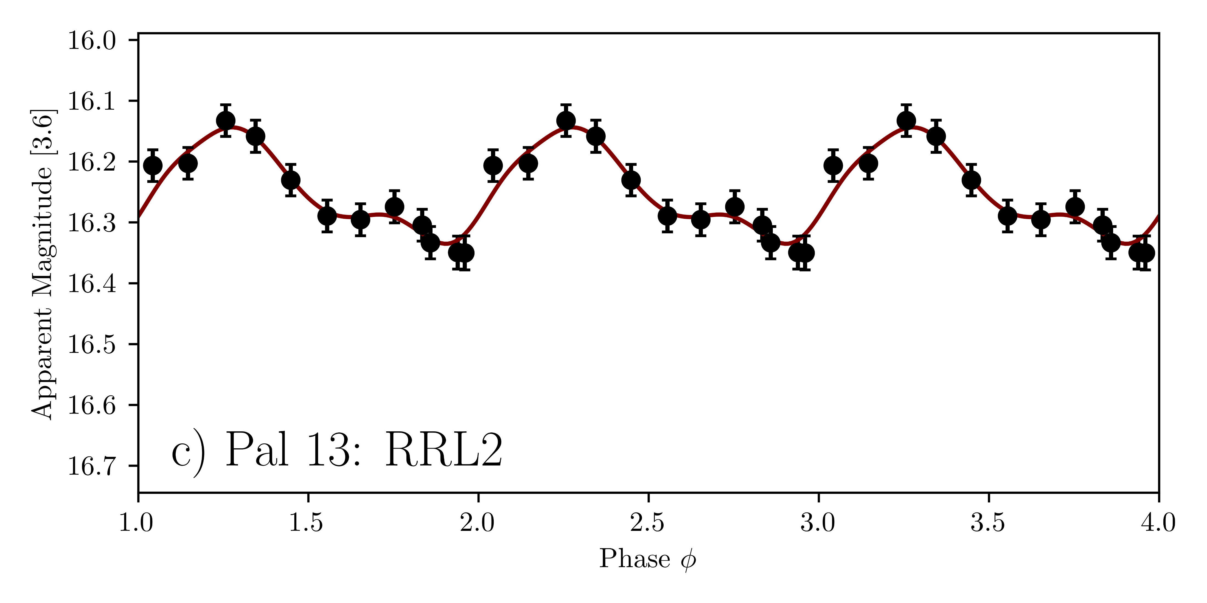
Light curves
Known RRLs extracted from final photometry lists using RRL catalogues [1, 2]
Light curves constructed using phased time domain
GLOESS used to fit curve
GLOESS:
Time-averaged apparent magnitude of each detected RRL
Average apparent magnitude uncertainty
Average magnitudes corrected for dust extinction
Period = 0.5971 days
[1] Clement C M et al. 2001 The Astronomical Journal 122 2587-2599
[2] Gaia Collaboration et al. 2018 Astronomy & Astrophysics 616 A1
Notes:
The known RR Lyraes in each channel for each cluster were extracted using catalogues of variable stars [1][2]. Light curves were plotted for each of these RR Lyrae stars. Light curves are useful for examining how a star’s magnitude varies with time and provides a visual check that the analysed RR Lyraes from our data do vary.
The time for each data point was converted into a phase to align each epoch and to make it easier to check that the periods join together smoothly as only 1 period of data was taken.
A light curve for an RRab star in Pal 13 is provided.
In order to calculate distances, an average apparent magnitude is required for each RR Lyrae. This was obtained using an algorithm called GLOESS, a Gaussian local estimation algorithm, which calculates the time-averaged apparent magnitude, alongside it’s uncertainty by considering the photometric uncertainty, the uncertainty in the fit and the uncertainty for the dust extinction; dust extinction was corrected for by subtracting the extinction magnitude from the average apparent magnitude and those values were obtained from a dust map of the milky way.

Slide 18
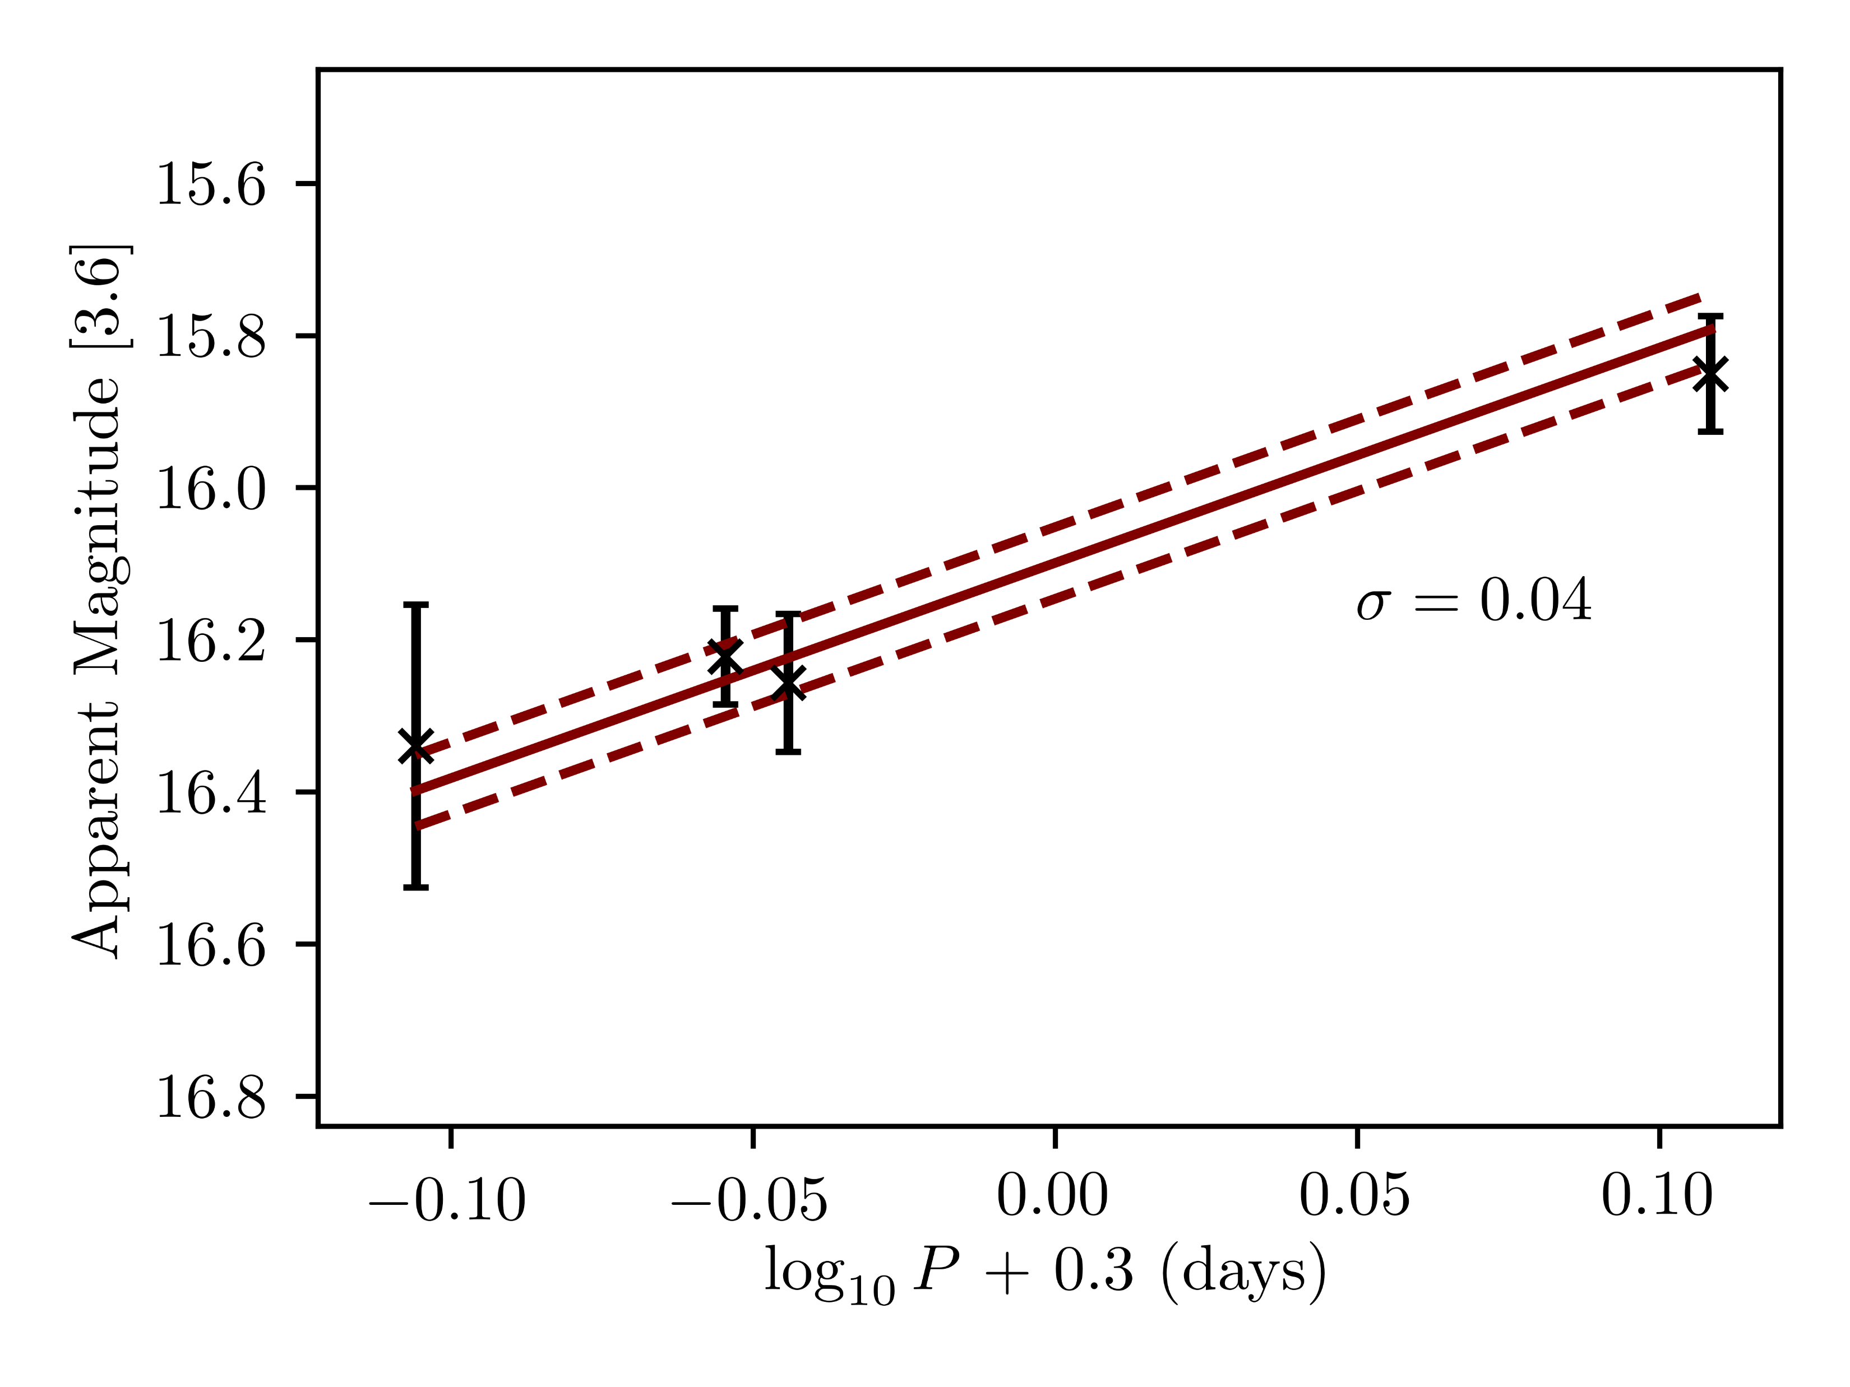
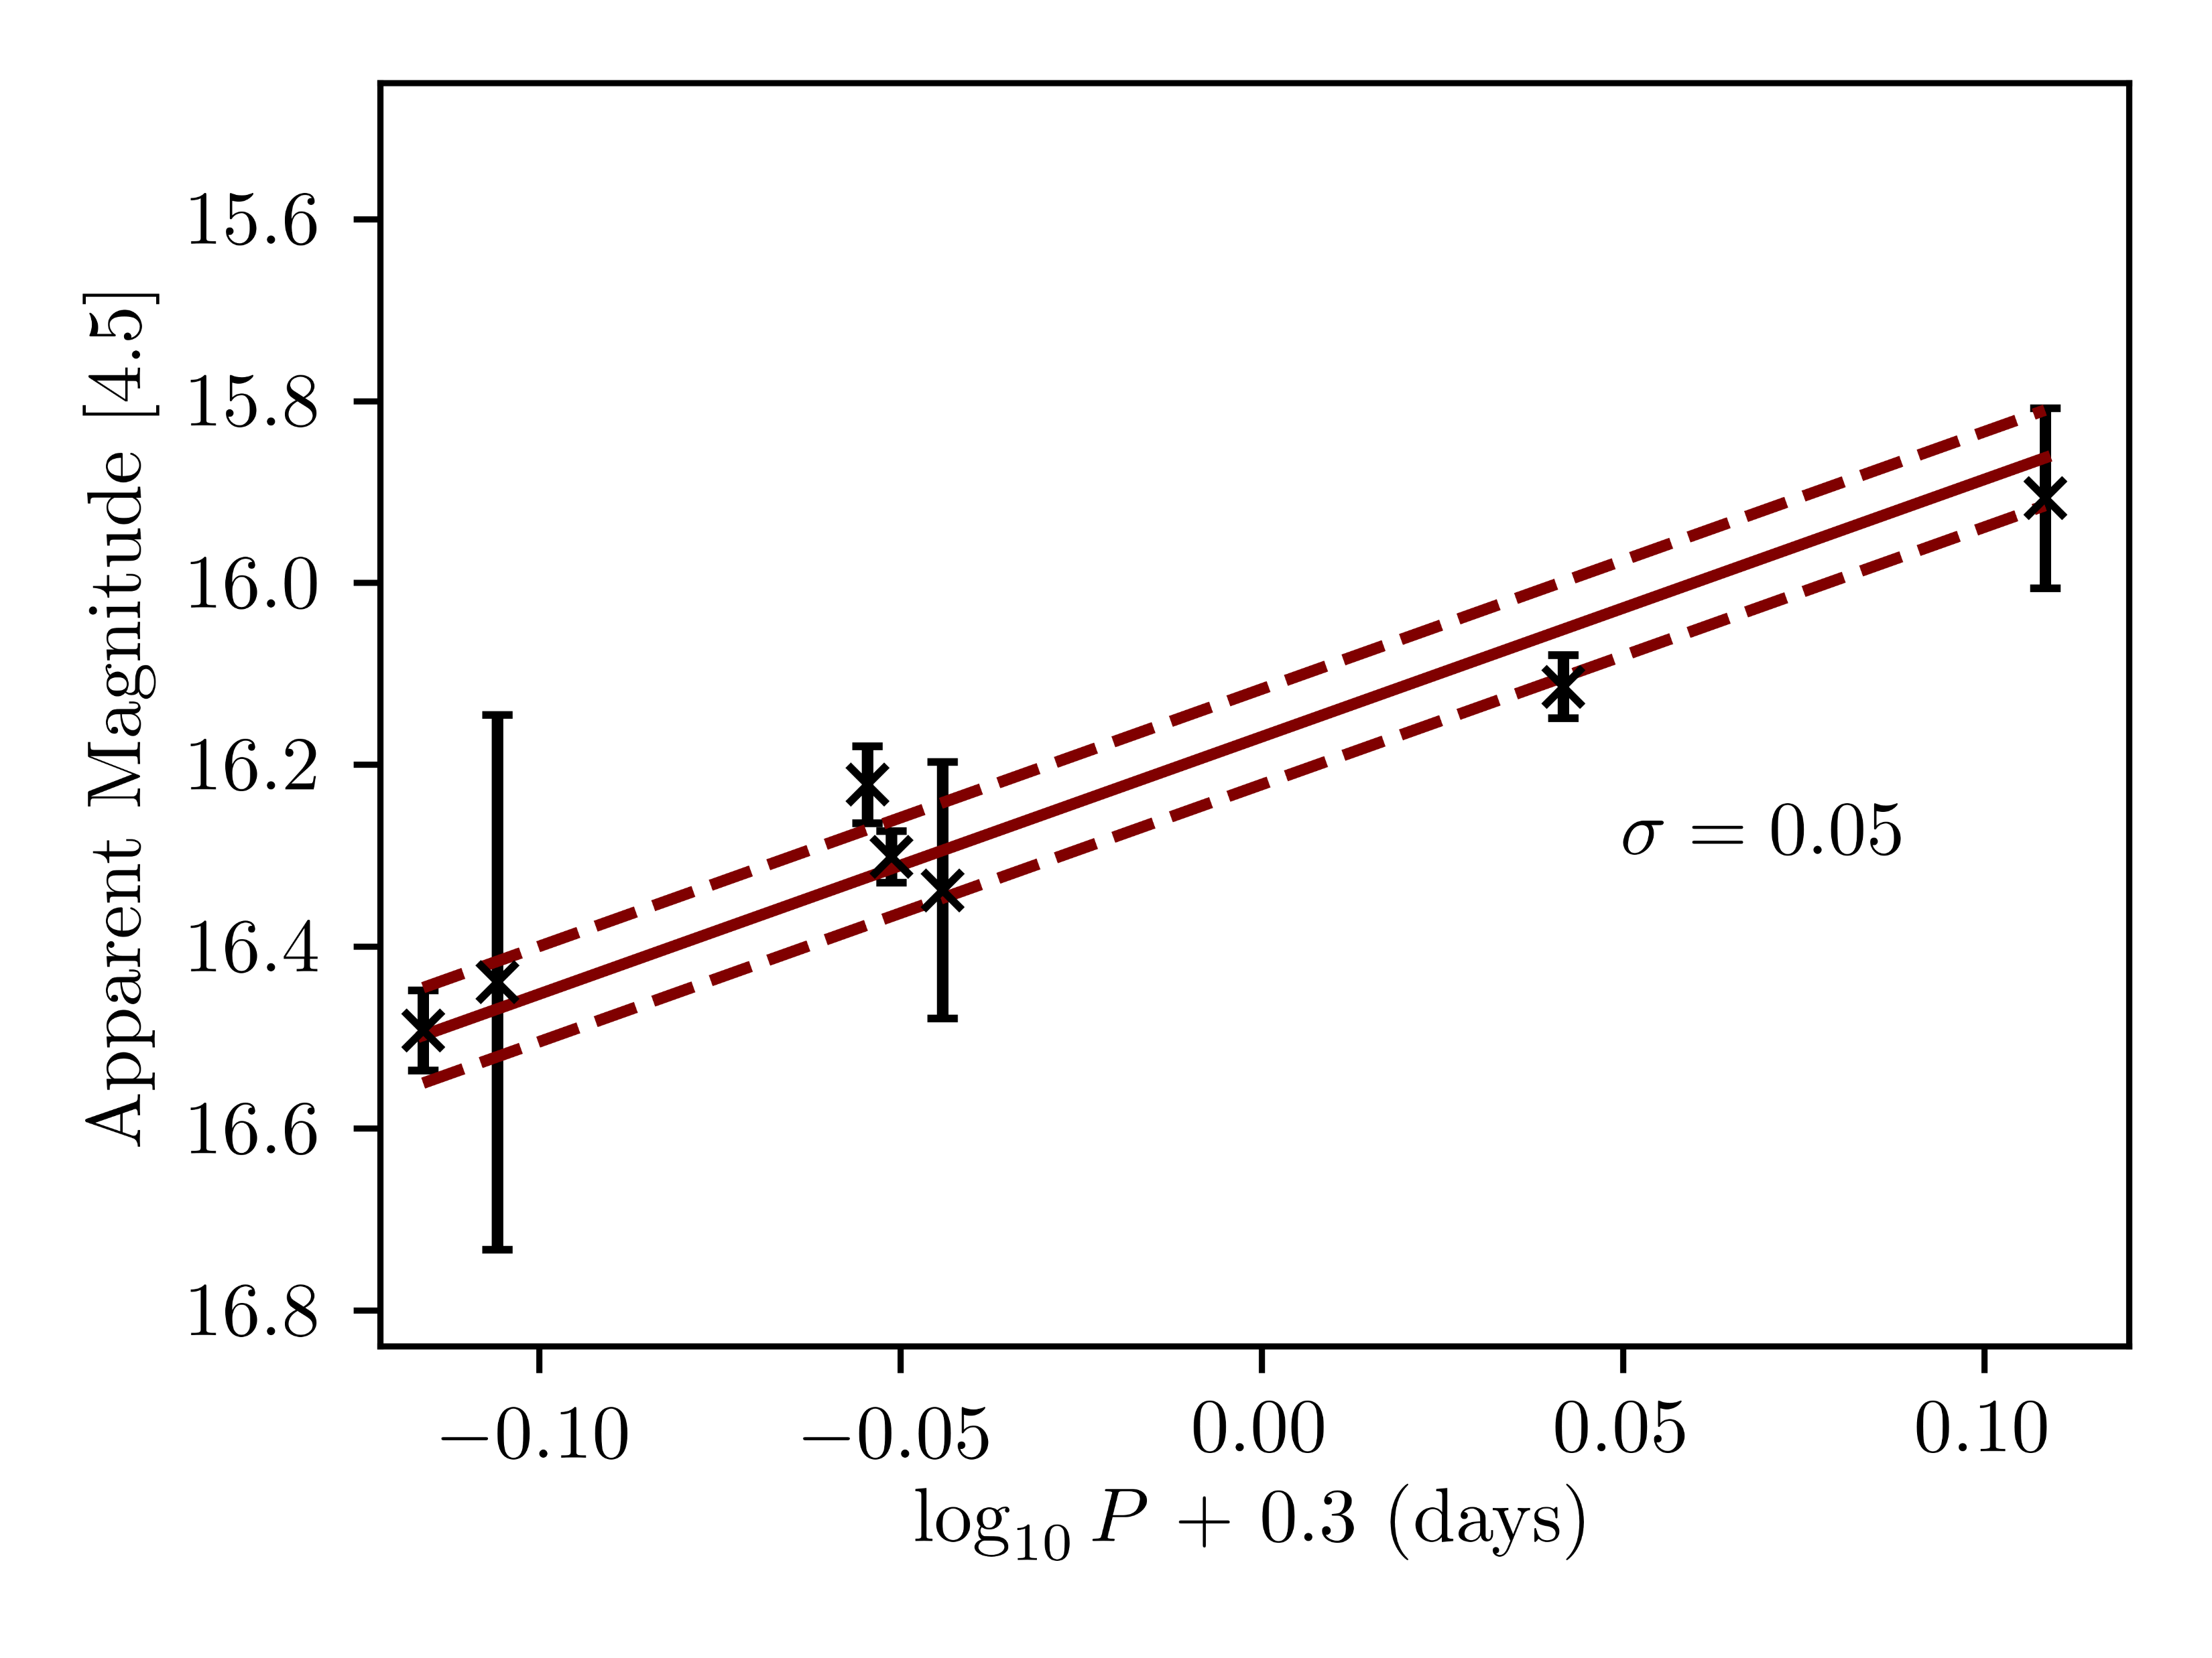
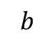
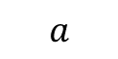
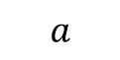
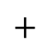
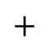
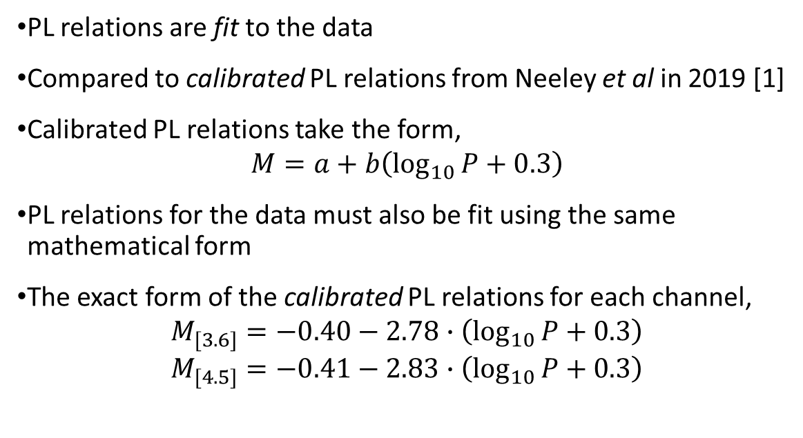
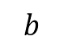
Fitting PL relations
a) Pal 5 PL relation (channel 1)
PL relations are fit to the data
Compared to calibrated PL relations from Neeley et al in 2019 [1]
Calibrated PL relations take the form,
$$M=a+b\left(\log_{10}{P}+0.3\right)$$
PL relations for the data must also be fit using the same mathematical form
The exact form of the calibrated PL relations for each channel,
$$M_{[3.6]}=−0.40−2.78∙\left(\log_{10}{P}+0.3\right)$$
$$M_{[4.5]}=−0.41−2.83∙\left(\log_{10}{P}+0.3\right)$$
b) Pal 5 PL relation (channel 2)
$$a$$
$$+$$
$$b$$
$$a$$
$$+$$
$$b$$
[1] Neeley J R et al. 2019 MNRAS 490 4254-4270
Notes:
A PL relation must be fit to the data in order to obtain distances. Calibrated PL relations for each IRAC channel were obtained from Neeley et al in 2019, as they contain the most recent RR Lyrae PL relations and have calibrations for both Spitzer IRAC channels. These calibrated PL relations, which are in ABSOLUTE magnitudes, take the form shown. So the PL relations fit to the data must follow the same mathematic form. The exact forms are shown below, and the values for the y-intercepts and gradients of the calibrated PL relations can now be unveiled, so we now know part of the puzzle. The next stage is to obtain the y-intercept values for the data, which is in APPARENT magnitudes, examples of which are shown for Pal 5 on the left by the solid lines.

Slide 19
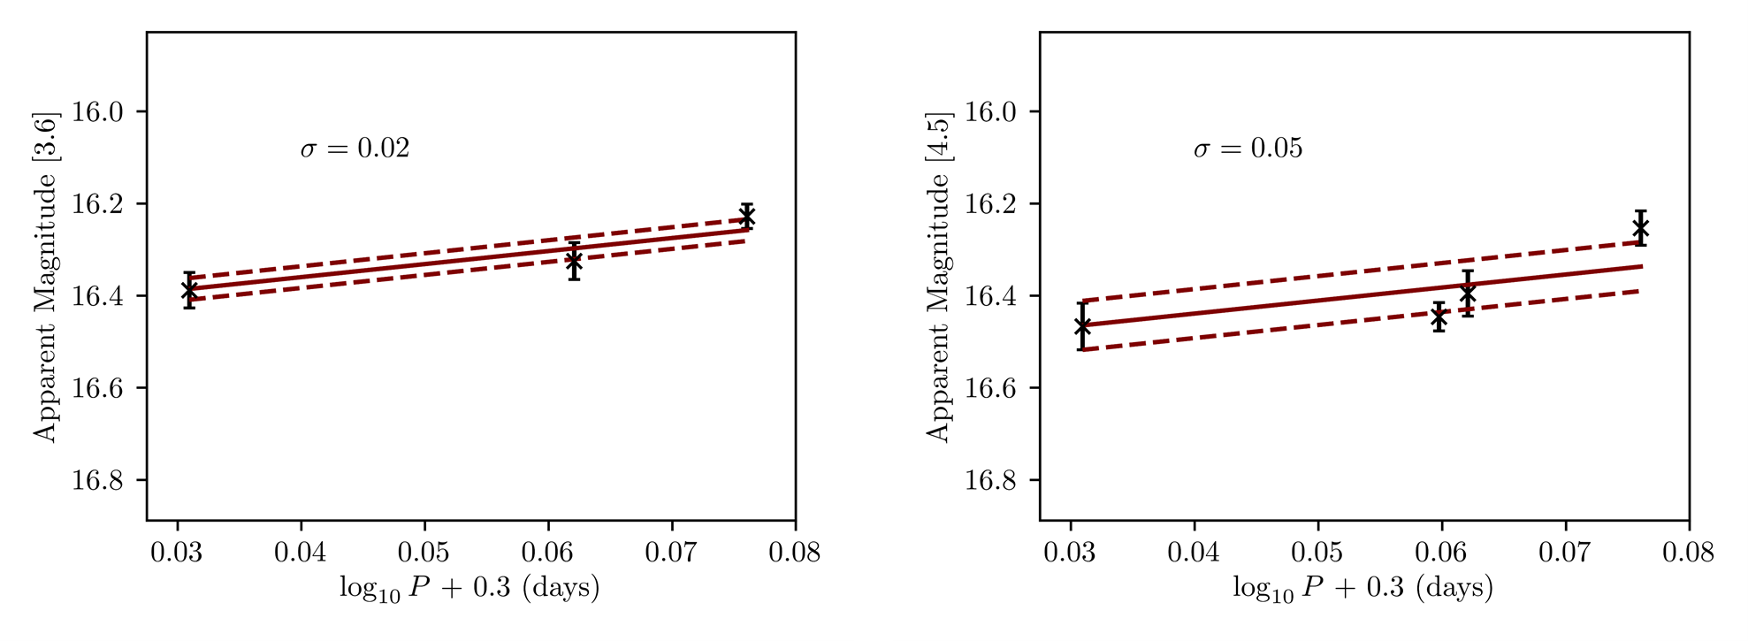
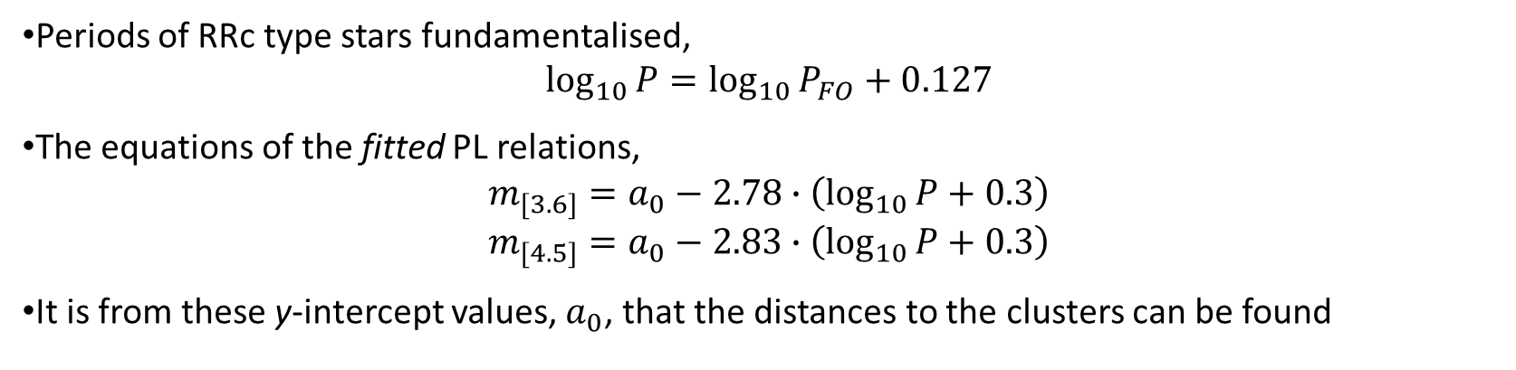
a) Pal 13 PL relation (channel 1)
b) Pal 13 PL relation (channel 2)
Periods of RRc type stars fundamentalised,
$$\log_{10}{P}=\log_{10}{P_{FO}}+0.127$$
The equations of the fitted PL relations,
$$m_{[3.6]}=a_{0}−2.78∙\left(\log_{10}{P}+0.3\right)$$
$$m_{[4.5]}=a_{0}−2.83∙\left(\log_{10}{P}+0.3\right)$$
It is from these y-intercept values, $a_{0}$, that the distances to the clusters can be found
Notes:
Before we fit the PL relations, the periods of the RRc type stars must be fundamentalised by using the equation given where Pfo is the first overtone period – this is done to enable comparisons between RRab and RRc stars using the same PL relation.
The equations of these fitted PL relations, the maroon lines on these graphs shown above, which are the PL relations for Pal 13 in both channels, are shown below. The gradient of the calibrated PL relation is held fixed, but the intercept is left to vary – a naught.

Slide 20
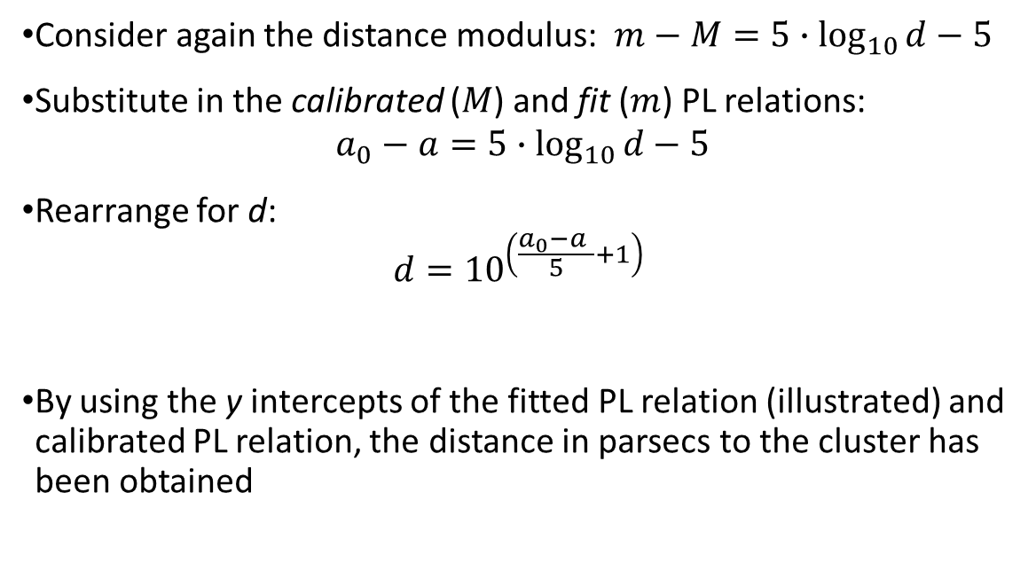
Distance calculations
a) Pal 5 PL relation (channel 1)
Consider again the distance modulus: $m−M=5∙\log_{10}{d}−5$
Substitute in the calibrated ($M$) and fit ($m$) PL relations:
$$a_{0}−a=5∙\log_{10}{d}−5$$
Rearrange for d:
$$d={10}^{\left(\frac{a_{0}−a }{5}+1\right)}$$
By using the y intercepts of the fitted PL relation (illustrated) and calibrated PL relation, the distance in parsecs to the cluster has been obtained
b) Pal 5 PL relation (channel 2)
Notes:
The y-intercepts of the fitted PL relations are obtained using a least-squares fit, but are illustrated by the blue dashed lines for the Pal 5 PL relations as shown in the figures. So consider again the distance modulus equation. By subtracting absolute magnitude from apparent magnitude, it is possible to find the distance in parsecs to the globular cluster. Substituting in the calibrated PL relations, big M, and the fitted PL relations, small m, the distance can be obtained from the difference between the y-intercepts, as shown.

Slide 21
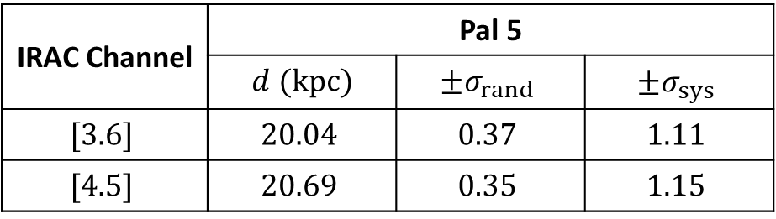
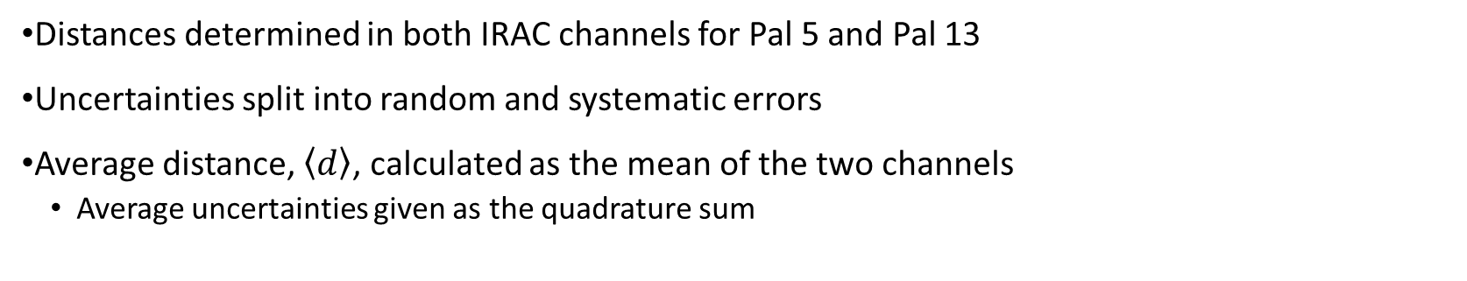
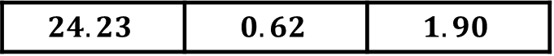
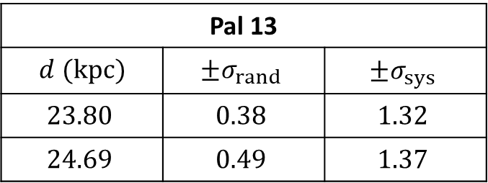
Results
IRAC Channel | Pal 5
 | $d$ $(kpc)$ | $$±σ_{rand}$$ | $$±σ_{sys}$$
$$[3.6]$$ | $$20.04$$ | $$0.37$$ | $$1.11$$
$$[4.5]$$ | $$20.69$$ | $$0.35$$ | $$1.15$$
Pal 13
$d$ $(kpc)$ | $$±σ_{rand}$$ | $$±σ_{sys}$$
$$23.80$$ | $$0.38$$ | $$1.32$$
$$24.69$$ | $$0.49$$ | $$1.37$$
$$\left\langle d\right\rangle$$ | $$20.37$$ | $$0.51$$ | $$1.60$$
$$24.23$$ | $$0.62$$ | $$1.90$$
Distances determined in both IRAC channels for Pal 5 and Pal 13
Uncertainties split into random and systematic errors
Average distance, $\left\langle d\right\rangle$, calculated as the mean of the two channels
Average uncertainties given as the quadrature sum
Notes:
These are the distance results obtained for both Pal 5 and Pal 13 in kiloparsecs.
The important results, the mean distance to each cluster is highlighted in bold: a distance of 20.37 kiloparsecs was obtained for Pal 5 and 24.23 kiloparsecs for Pal 13.
The uncertainties have been split into two categories, random and systematic, due to the disparity between the two types of uncertainty, as seen in the table.
The average distance was calculated as simply the mean between the two channels, and the average uncertainties were calculated in quadrature with respect to each channel.

Slide 22



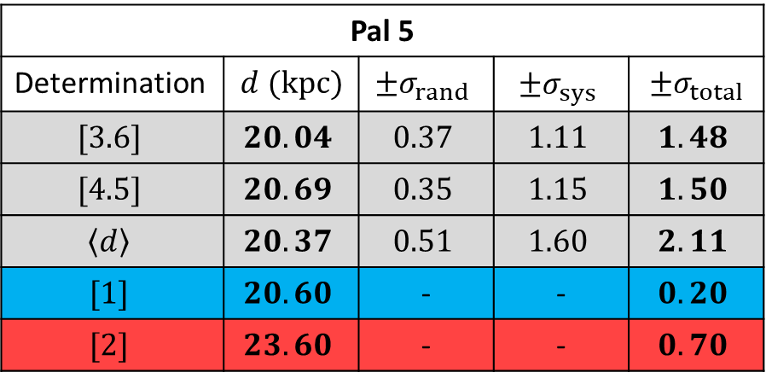
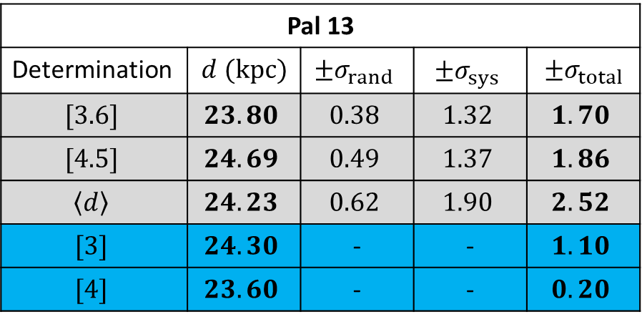
Comparison of results to the literature
Pal 5
Determination | $d$ $(kpc)$ | $$±σ_{rand}$$ | $$±σ_{sys}$$ | $$±σ_{total}$$
$$[3.6]$$ | $$20.04$$ | $$0.37$$ | $$1.11$$ | $$1.48$$
$$[4.5]$$ | $$20.69$$ | $$0.35$$ | $$1.15$$ | $$1.50$$
$$\left\langle d\right\rangle$$ | $$20.37$$ | $$0.51$$ | $$1.60$$ | $$2.11$$
$$[1]$$ | $$20.60$$ | - | - | $$0.20$$
$$[2]$$ | $$23.60$$ | - | - | $$0.70$$
Pal 13
Determination | $d$ $(kpc)$ | $$±σ_{rand}$$ | $$±σ_{sys}$$ | $$±σ_{total}$$
$$[3.6]$$ | $$23.80$$ | $$0.38$$ | $$1.32$$ | $$1.70$$
$$[4.5]$$ | $$24.69$$ | $$0.49$$ | $$1.37$$ | $$1.86$$
$$\left\langle d\right\rangle$$ | $$24.23$$ | $$0.62$$ | $$1.90$$ | $$2.52$$
$$[3]$$ | $$24.30$$ | - | - | $$1.10$$
$$[4]$$ | $$23.60$$ | - | - | $$0.20$$
Key:
Result obtained in this project
Consistent literature result
Inconsistent literature result
[1] Price-Whelan A M et al. 2019 The Astronomical Journal 158 223
[2] Küpper A H W et al. 2015 The Astrophysical Journal 803 80
[3] Côté et al. 2002 The Astrophysical Journal 574 783-804
[4] Shipp et al. 2020 The Astronomical Journal 160 244
Notes:
The table here represents the comparison between my results, shaded in light grey, and literature results, using independent methods, shown in either blue or red. The main important information has been emboldened.
So for Pal 5: In the first paper, by Price-Whelan et al in 2019, obtained a value of 20.60 plus or minus 0.2, as an overall uncertainty, kiloparsecs for their distance to Pal 5. This agrees very well with all three values obtained in this project. However, the second paper, which has been highlighted red, by Kupper, is inconsistent with the results. This paper is based on a model of Pal 5 and it’s stream and as discussed by Price-Whelan et al in their paper, this result of 23.60 kiloparsecs was perhaps overestimated based on previous data. It is possible dust extinction was not taken into account here, and because dust causes a reddening effect, which essentially shifts the PL relation down, giving a larger distance. This perhaps highlights the advantages of mid-IR observations over optical or near-IR and so it will be interesting to see if updated models of Pal 5 and its dynamics will reflect these changes.
And for Pal 13: There is very good agreement for both literature values here, given by Cote and Shipp in 2002 and 2020 respectively.
Now an extra note on the Pal 13 values: there is a large difference between the channel 1 and channel 2 values, almost 1 kiloparsec difference – this is most likely due to the lower SNR in channel 2 but not only that there were only 3 RR Lyraes in channel 1 and 4 in channel 2, which is a very small sample.

Slide 23
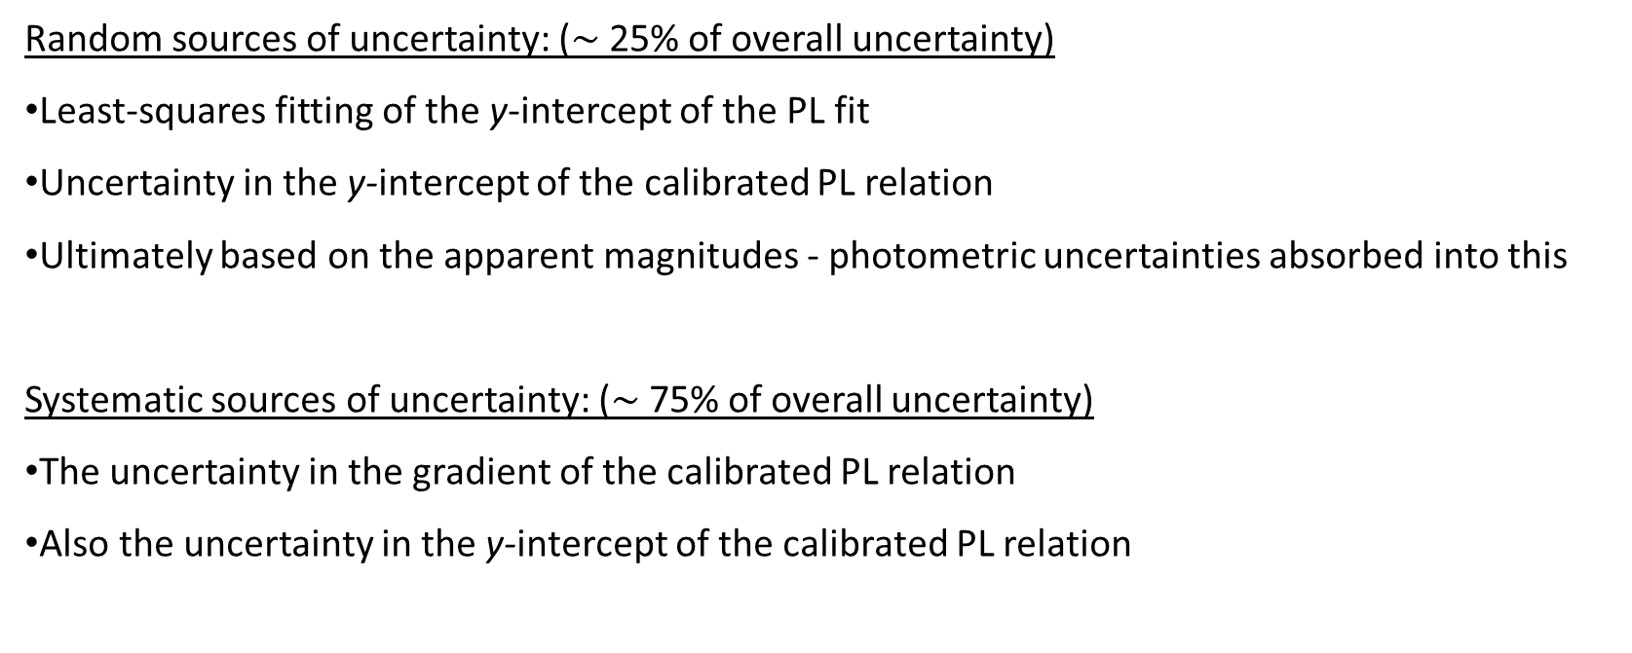
Distance measurement uncertainties
Random sources of uncertainty: ($\sim$25% of overall uncertainty)
Least-squares fitting of the y-intercept of the PL fit
Uncertainty in the y-intercept of the calibrated PL relation
Ultimately based on the apparent magnitudes - photometric uncertainties absorbed into this
Systematic sources of uncertainty: ($\sim$75% of overall uncertainty)
The uncertainty in the gradient of the calibrated PL relation
Also the uncertainty in the y-intercept of the calibrated PL relation
Notes:
The uncertainties in the distance values obtained have been split into two main categories: random error, which accounted for around 25% of the overall uncertainty for both clusters and systematic error, which accounted for around 75% of the overall uncertainty.
Random sources of error came from: the least squares fitting for the y intercept of the PL fit, the uncertainty in the calibrated PL relation’s y intercept and, by extension, photometric uncertainties in the apparent magnitudes caused by background noise, blending of the RR Lyraes (which was observed in one case) and crowding. These uncertainties are absorbed into the random error.
Systematic sources, by far the main contributor of uncertainty, came from: the uncertainty in the gradient of the PL relation, as given in the Neeley et al 2019 paper, as well as the uncertainty in the y intercept of the calibrated PL relation

Slide 24
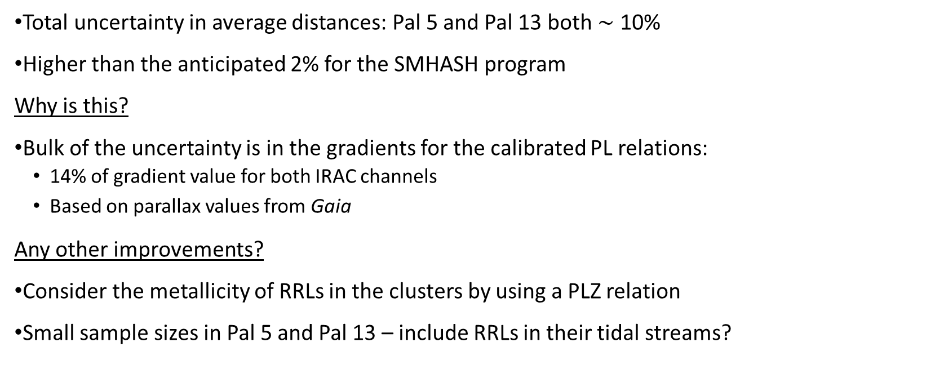
Analysis of the distances
Total uncertainty in average distances: Pal 5 and Pal 13 both $\sim$ 10%
Higher than the anticipated 2% for the SMHASH program
Why is this?
Bulk of the uncertainty is in the gradients for the calibrated PL relations:
14% of gradient value for both IRAC channels
Based on parallax values from Gaia
Any other improvements?
Consider the metallicity of RRLs in the clusters by using a PLZ relation
Small sample sizes in Pal 5 and Pal 13 – include RRLs in their tidal streams?
Notes:
The overall uncertainties in the mean distances to both Pal 5 and Pal 13 were around 10%, which is much higher than the anticipated 2% for the SMHASH program. So, why is this? The bulk of the uncertainty is caused by the uncertainty of the gradients, contributing to around 75% of the overall uncertainty. The uncertainties in the gradients themselves were around 14% of the values for bath channels. The PL relations in Neeley et al 2019 were based on Gaia parallax values, which came with large uncertainties themselves, and so improvements in these values which will come with future Gaia data releases could significantly improve the uncertainty in these distances.
Other improvements can also be made by considering the metallicity of the RR Lyraes in the clusters using a period-luminosity-metallicity, PLZ, relation when that data becomes available in Gaia. Another improvement could perhaps come by including the RR Lyraes in the tidal streams of the clusters to increase the sample sizes.

Slide 25
Looking towards the future
Future work and improvements:
Apply the work to more globular clusters (such as IC4499)
Consider the metallicities of the samples
Future developments in the field:
Improvements in Gaia parallax values could reduce uncertainty in the PL relations
This would decrease the “error budget” for determining the Hubble constant
Uncertainties of less than 2% could be achieved for the Hubble constant
Implications on our understanding of the Universe from by resolving the inconsistency in the Hubble constant
Notes:
This work could be extended by applying the work to other globular clusters, such as the crowded IC4499 and also considering the metallicities of the samples if the data is available for that cluster.
In terms of the field, improvements in Gaia parallax values could reduce the uncertainties in the PL relations, or just general improvements in PL relations for RR Lyraes would significantly decrease say, the error budget for determining the Hubble constant.
It will hopefully be possible for uncertainties in the region of 2-3% or less to be achieved for the Hubble constant - as the cosmic distance ladder is climbed – and so more and more precise values could be obtained to resolve this inconsistency in values for the Hubble constant and in turn, significantly improve our understanding of the age, size and evolution of the universe!
Thank you for coming to my talk!
If time:
Acknowledge: Dr Victoria Scowcroft, Miss Abigail Chown and Mr Jake Bird

